Slide 1
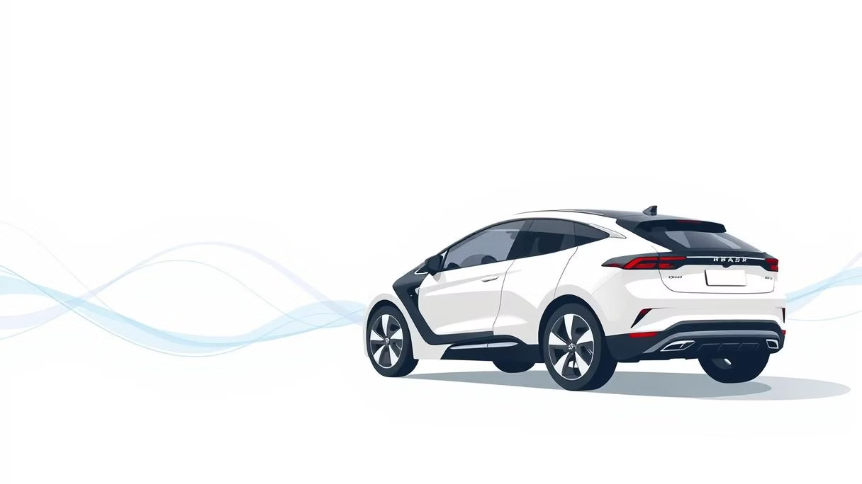
Electric Vehicle Population Data
Aron Shakha
LCID: LC00017001869

Slide 2
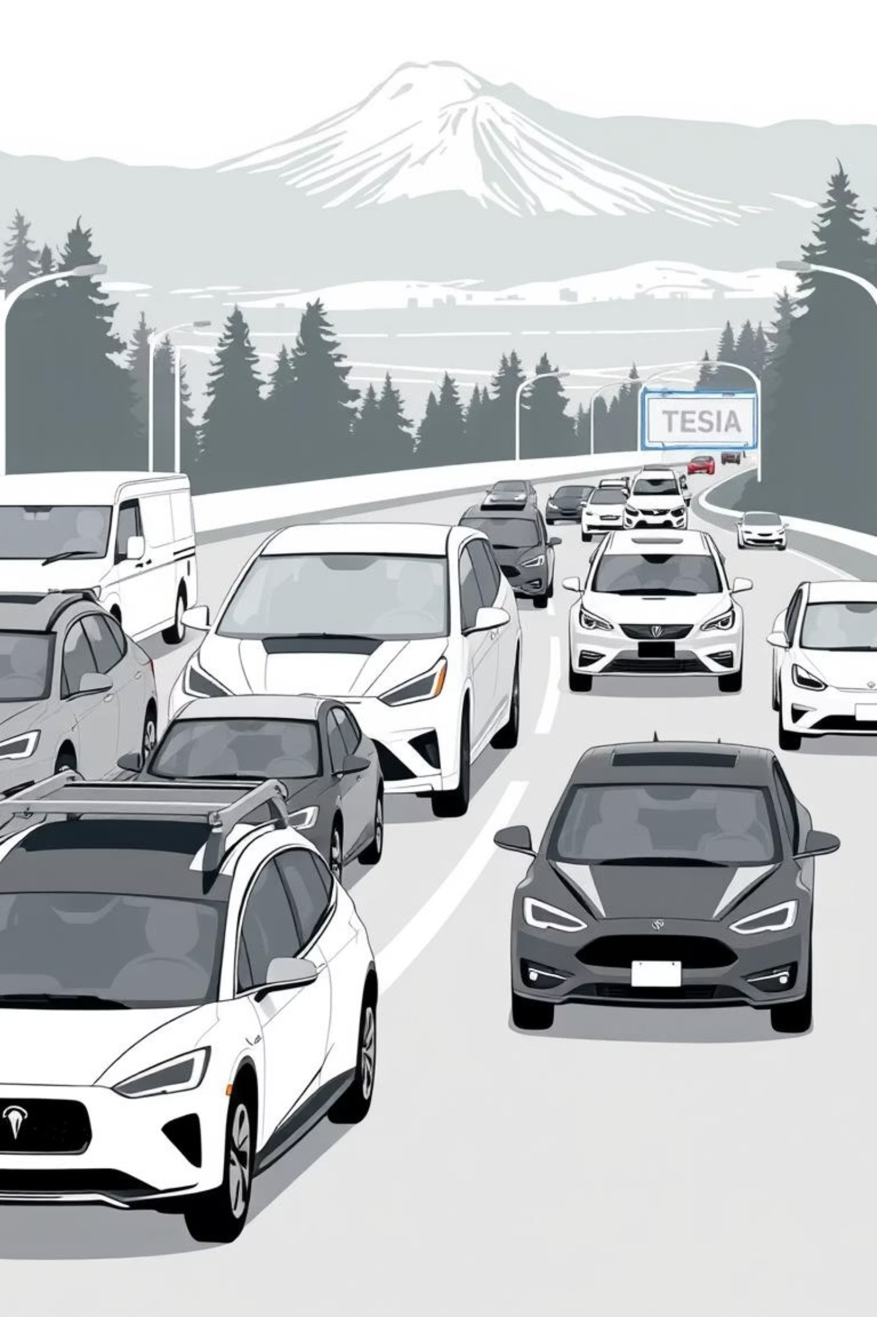
Introduction: The Rise of EVs
Electric vehicles are transforming transportation, offering a sustainable alternative to fuel-based cars. The Washington State Electric Vehicle Population dataset provides a rich source of information on registered Battery Electric Vehicles (BEVs) and Plug-in Hybrid Electric Vehicles (PHEVs).
This data allows us to investigate population trends, popular models, average electric ranges, and regional dispersion across cities and counties.

Slide 3
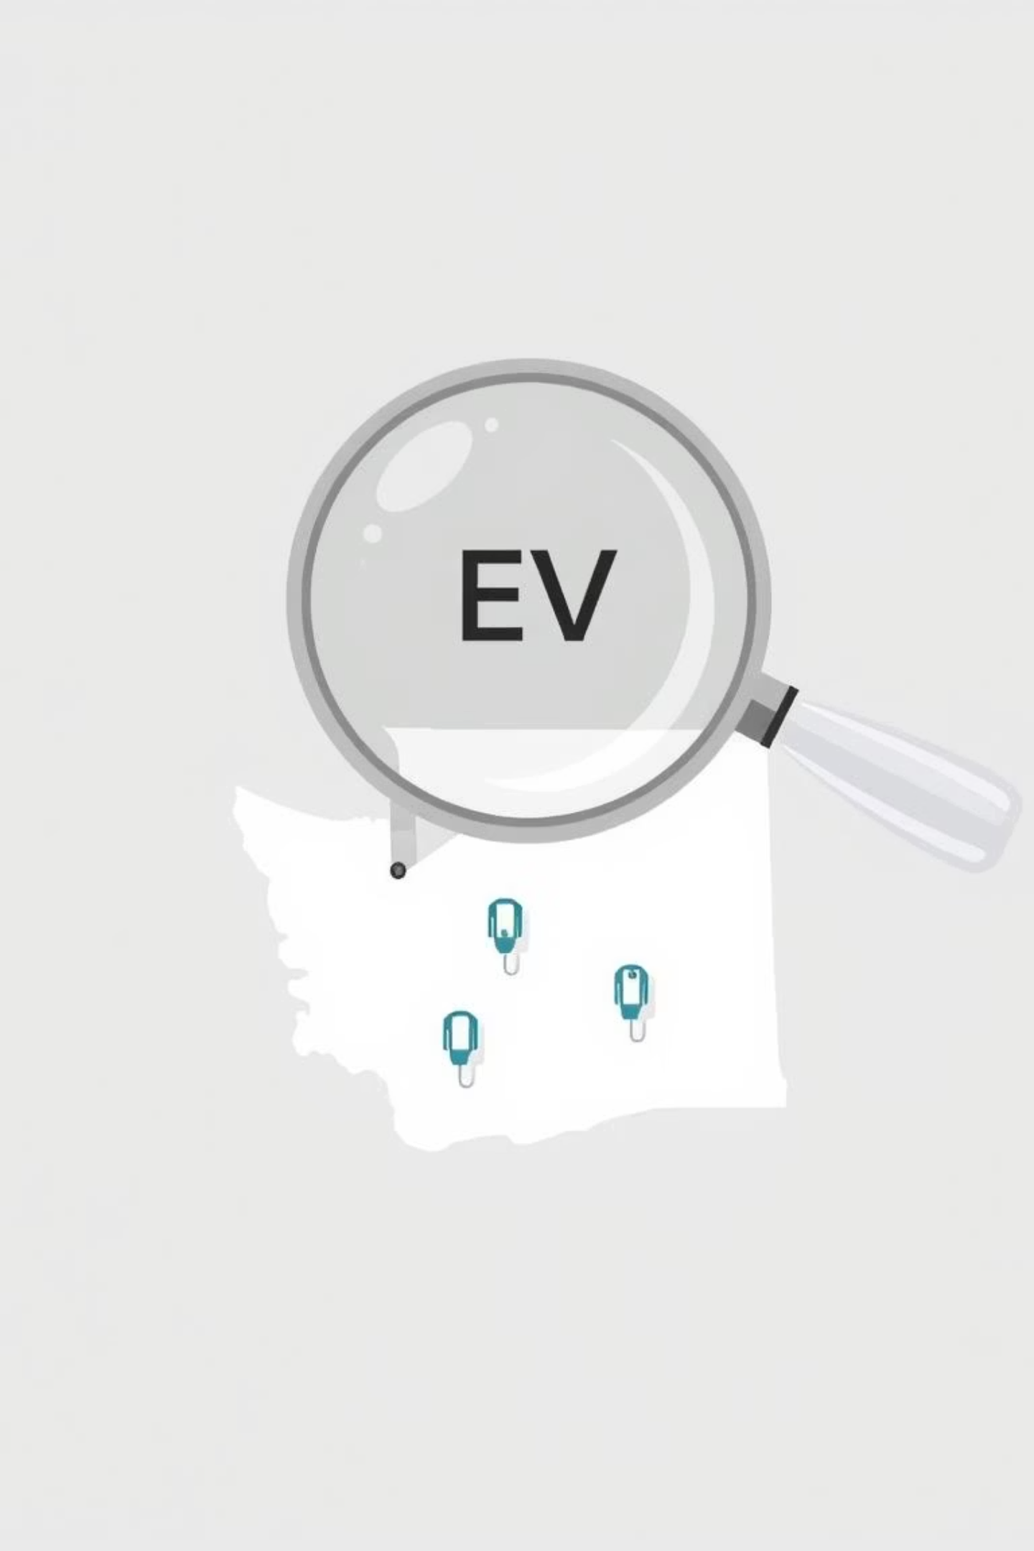
Unveiling EV Adoption Trends
Problem Statement
Despite the comprehensive database, trends, distributions, and characteristics influencing EV adoption in Washington State remain largely unknown.
Project Goal
This project aims to uncover the distribution of EVs, identify common manufacturers, analyze electric ranges, and map the geo-location of adoption.

Slide 4

Project Objectives: Key Insights
01
General Objective
Analyze the Washington State EV Population dataset to identify key insights about EV adoption and characteristics.

Slide 5

Specific Objectives: A Deep Dive
Data Exploration
Clean and explore the EV dataset.
Distribution Analysis
Analyze BEV vs. PHEV distribution.
Manufacturer Insights
Identify top manufacturers and models.
Range & Model Year
Examine electric range and model year patterns.
Regional Distribution
Analyze regional EV distribution.
Visual Insights
Present visual insights and recommendations.

Slide 6

Scope of the Project
Data Preprocessing
Cleaning and preprocessing of the dataset.
Descriptive Analysis
Visualizations and descriptive analysis.
Geographic Insights
Insights into geographic distribution.
Summary & Recommendations
Project summary and actionable recommendations.

Slide 7
Proposed Modules & Features
Data Loading
1
Module for efficient data ingestion.
2
Data Cleaning
Preprocessing and transformation.
Exploratory Analysis
3
Initial data insights (EDA).
4
Distribution Analysis
BEV vs. PHEV breakdown.
Manufacturer Insights
5
Top brands and models.
6
Range Analysis
Electric range patterns.
Geographic Distribution
7
Regional EV adoption.
8
Visualization & Reporting
Interactive dashboards.

Slide 8

Tools of the Trade
PostgreSQL (pgAdmin)
For robust data management.
Power BI
For dynamic visualization and dashboard creation.
Python
With pandas and scikit-learn for EV grouping.

Slide 9

Anticipated Outcomes
This project is expected to yield valuable insights into EV adoption in Washington State, providing a clearer picture of market dynamics and consumer preferences.
The findings will support informed decision-making for policymakers, manufacturers, and consumers in the evolving EV landscape.

